Slide 1







Volume Transformer:
Revisiting Vanilla Transformers for 3D Scene Understanding
SceneFUN3D Functionality Segmentation Challenge Winner
ScanNet++ Semantic and Instance Segmentation Challenge Winner
Kadir
Yilmaz*
Adrian
Kruse*
Tristan
Höfer
Daan
De Geus
Bastian
Leibe
* Equal Contribution
Notes:
Hello everyone. I will present our new 3D backbone, Volume Transformer, with which, we won 3 challenges at this CVPR one of which is the Scenefun3D.

Slide 2

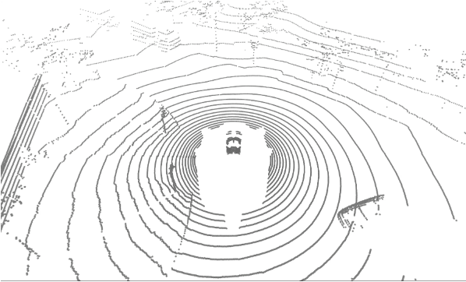
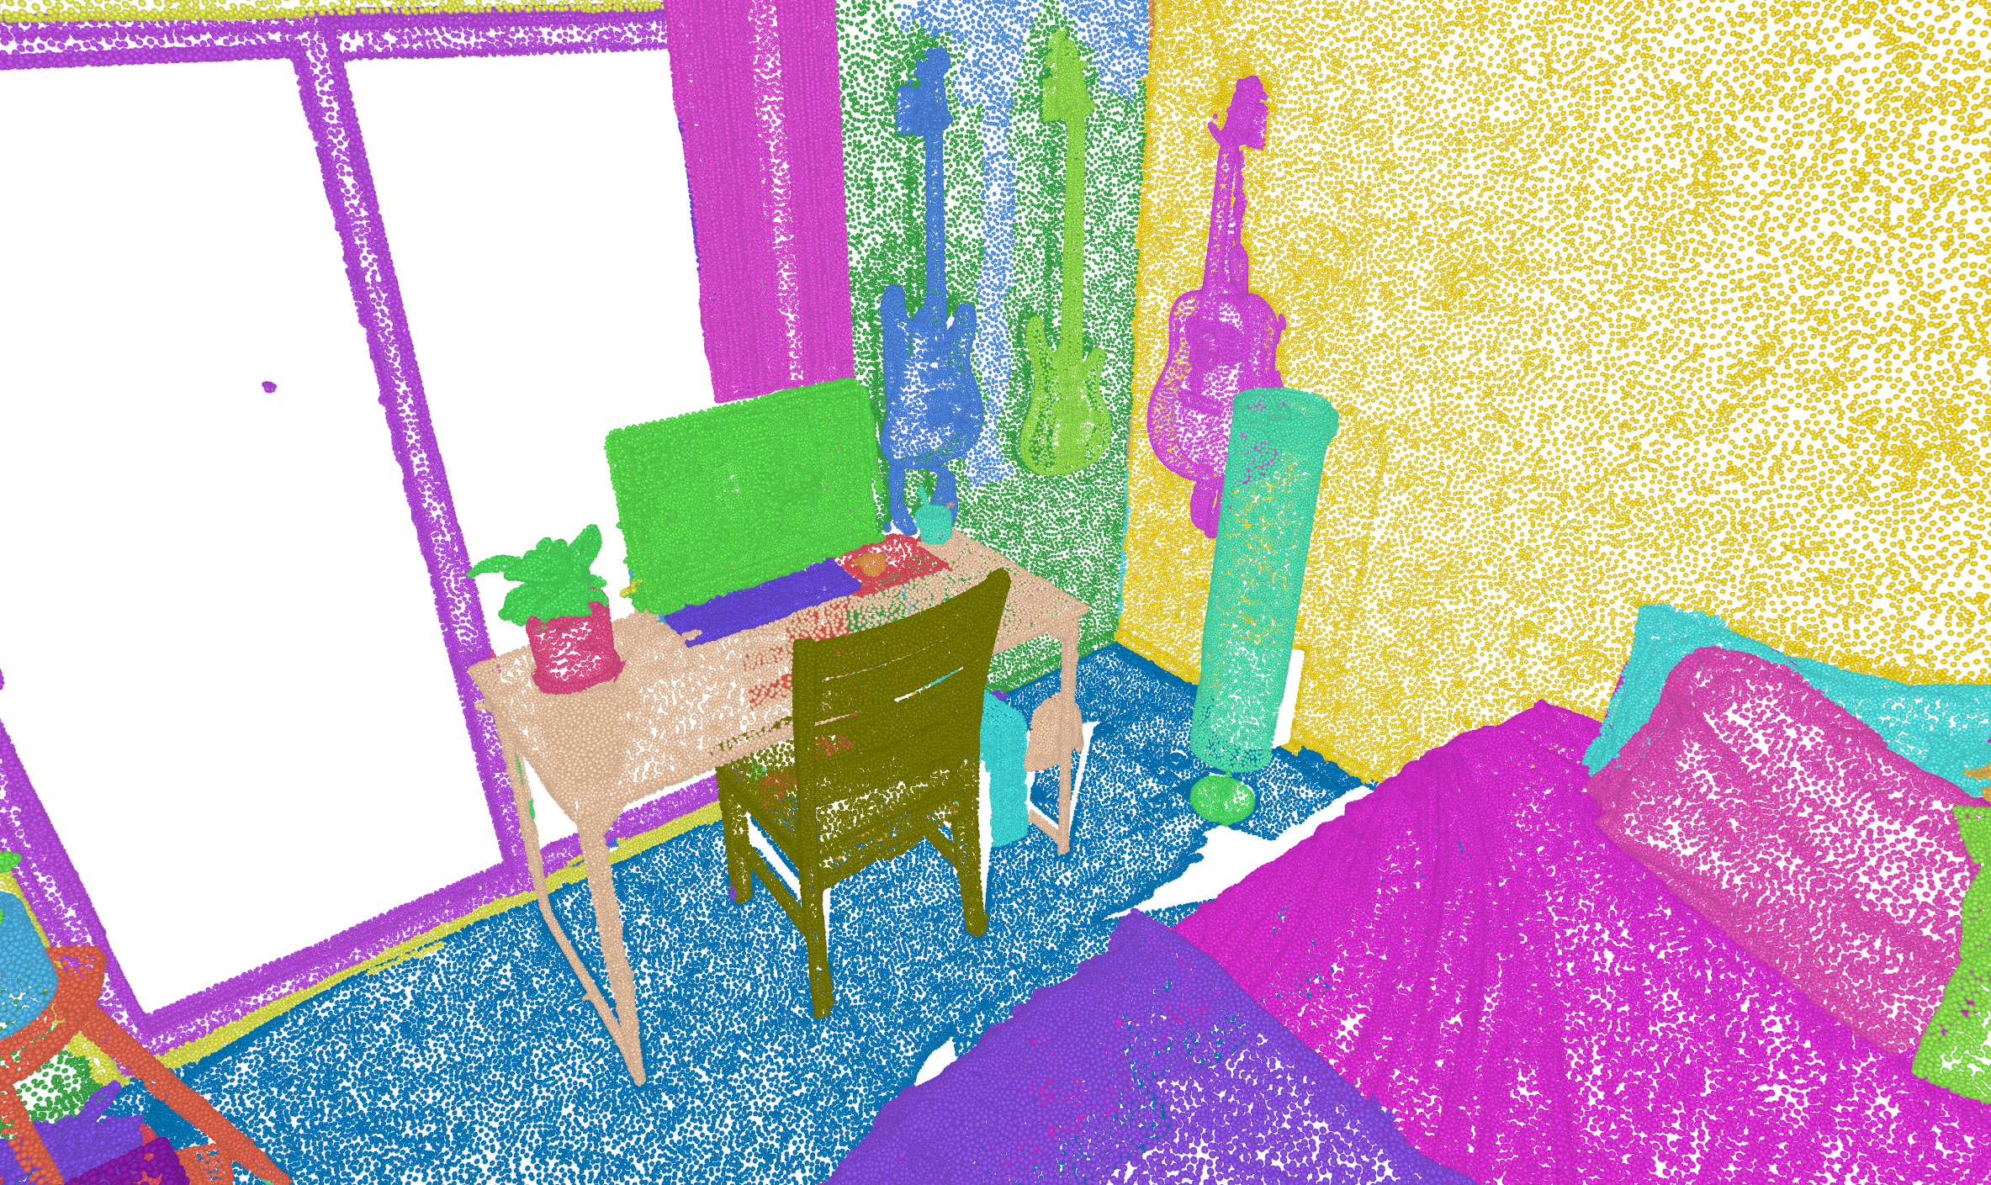
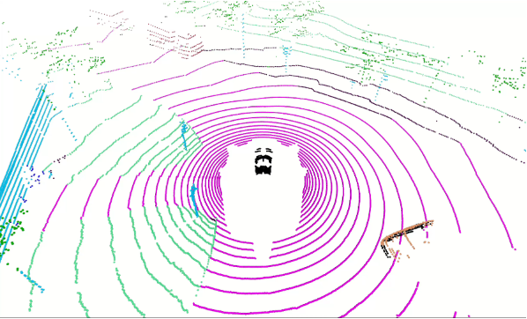
Task: 3D Scene Understanding
RGB-D Point Clouds (ScanNet++)
LiDAR Point Clouds (nuScenes)
Notes:
Let me first define the task. The input is a 3D scene which could be an RGB-D point cloud or a Lidar point cloud we basically want to segment the point cloud. It is a quite fundamental task.

Slide 3






Current Paradigm: 3D U-Nets
Convolution
+
Convolution
RGB-D Point Clouds (ScanNet++)
3D U-Net
MinkUNet
$$ℰ1$$
$$ℰ2$$
$$ℰ3$$
$$𝒟3$$
$$𝒟2$$
$$𝒟1$$
Notes:
Okay, lets briefly look at the 3D semantic segmentation literature. For quite some time, MinkowskiNet was quite popular. If you don’t know it, it is basically a fully convolutional 3D U-Net and it is still commonly used as a backbone in many 3D pipelines.

Slide 4
Current Paradigm: 3D U-Nets
Convolution
+
Local Attention
RGB-D Point Clouds (ScanNet++)
3D U-Net
Point“Transformer”v3
$$ℰ1$$
$$ℰ2$$
$$ℰ3$$
$$𝒟3$$
$$𝒟2$$
$$𝒟1$$
Notes:
The current best performing model is Point "Transformer" v3, but it is not really a transformer but more of a Unet with hybrid convolution and local attention blocks. So, I think it is fair to say that 3D UNets are still the dominant paradigm.

Slide 5
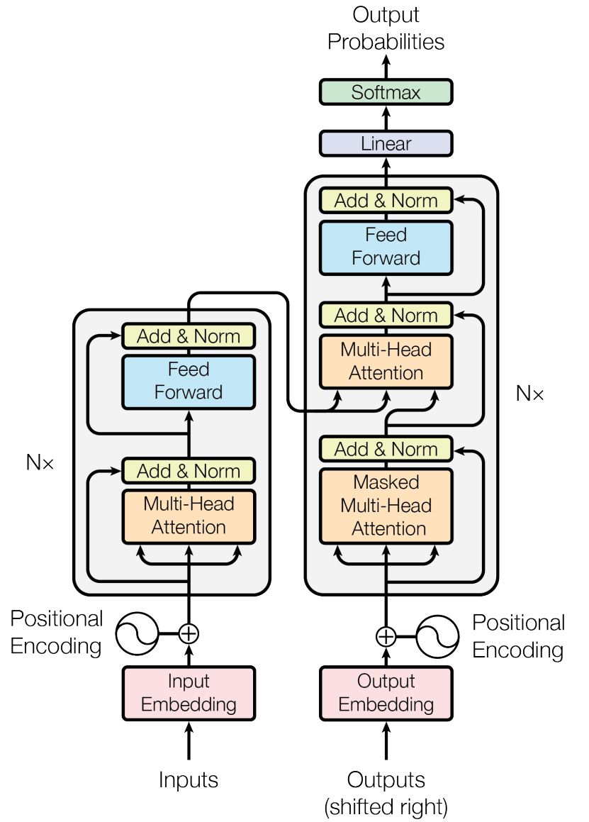
Everyone Else: Transformers
Computer Vision
Natural Lang. Proc.
Reinf. Learning
Speech
Translation
Slide is taken by “Transformer Tutorial” of Lucas Beyer
Transformer image is taken by "Attention Is All You Need" paper
Notes:
On the other hand, as you all know, all other deep learning fields converged to Transformers. All these fields use transformers

Slide 6

Everyone Else: Transformers
Computer Vision
Natural Lang. Proc.
Reinf. Learning
Speech
Translation
3D vision
$$ℰ1$$
$$ℰ2$$
$$ℰ3$$
$$𝒟3$$
$$𝒟2$$
$$𝒟1$$
Slide is taken by “Transformer Tutorial” of Lucas Beyer
Transformer image is taken by "Attention Is All You Need" paper
Notes:
Except 3D vision which remains the outlier and continue to use 3D specific architectures.

Slide 7
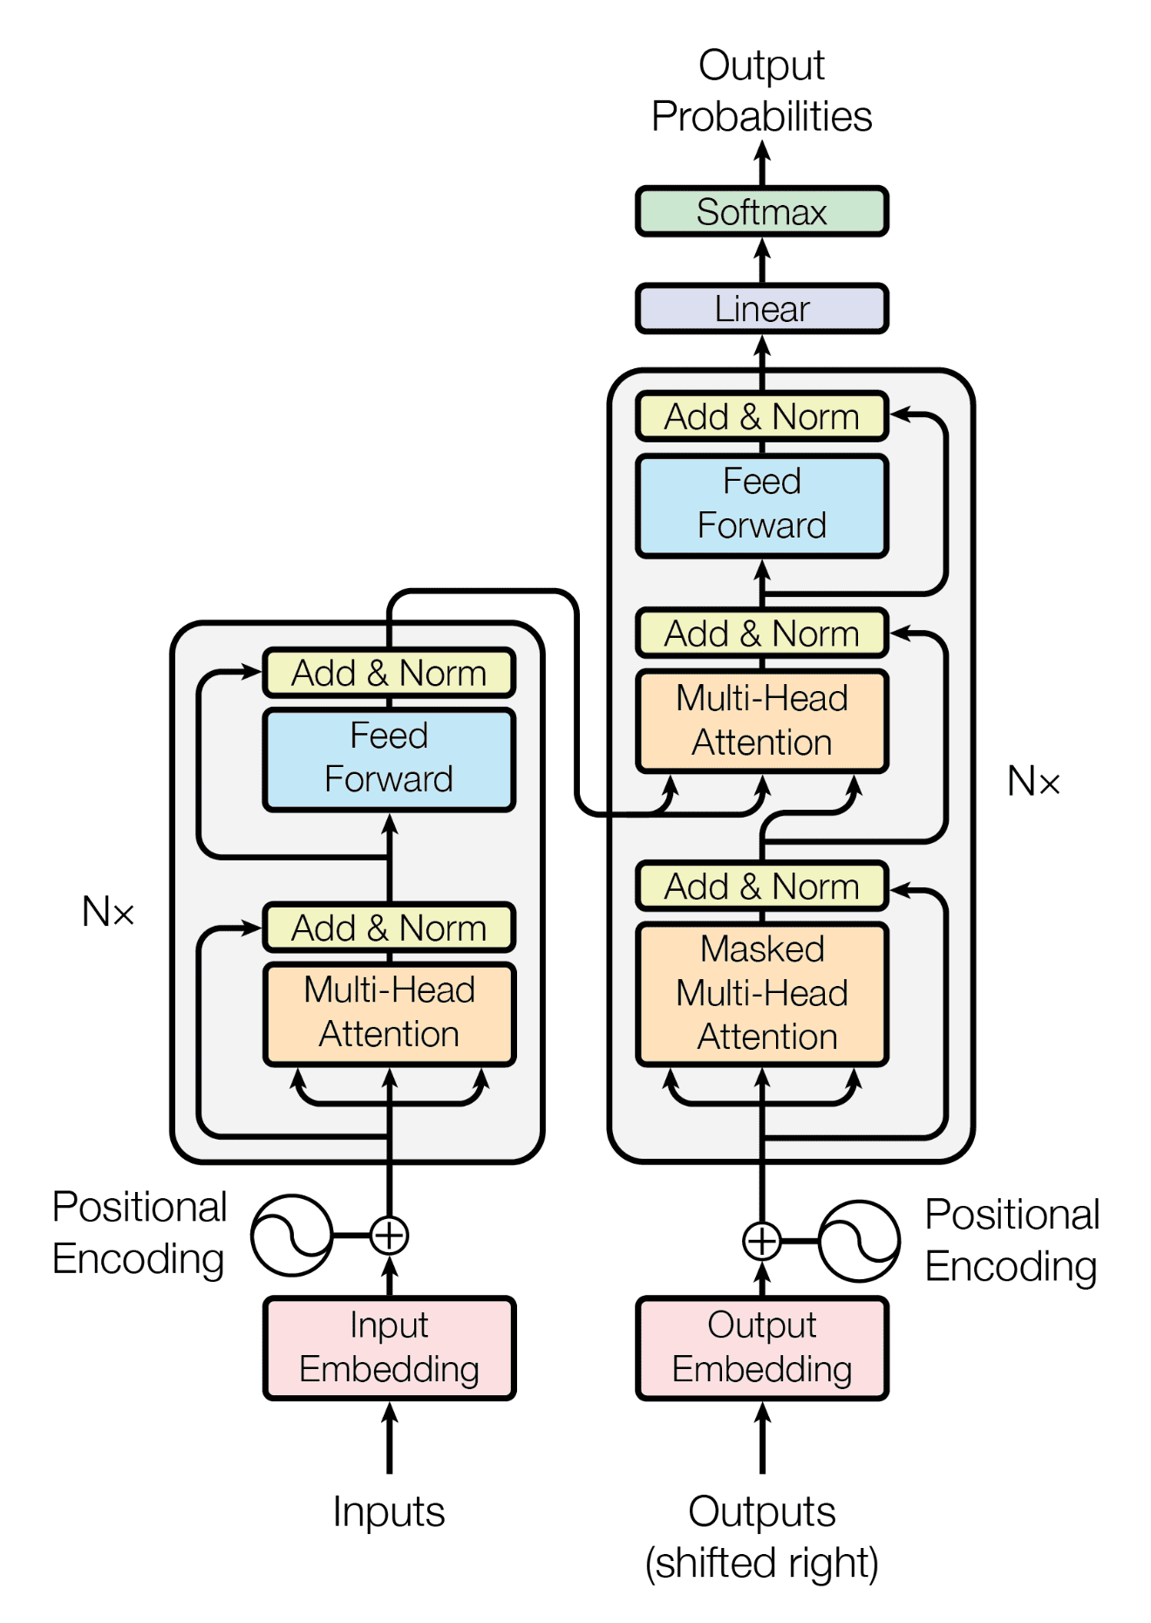
Downsides of 3D-Specific Architectures
Inductive biases can be limiting
  Convolutions and hand-designed local attention layers are useful at small scale
  But they can limit the model’s ability to learn complex patterns or long-range dependencies
Isolates 3D research
  Most research is on Transformers (Muon Optimizer, SSL techniques: MAE, DINO, MoE, QKNorm)
  Hardware/software are focused on the Transformer workloads (H100, GB200, FlashAttention4)
Notes:
So why is this a problem? First, the inductive bias argument. Convolutions and these hand-designed attention layers are helpful when data is limited, but as the data and compute increase, they can limit the model’s ability to learn complex patterns. Secondly, task-specific architectures isolate 3D research from the broader deep learning community. Most of the research happens around Transformers. Also, new GPUs and software implementations are optimized for Transformer workloads. But 3D community cannot fully benefit from all these advancements.

Slide 8
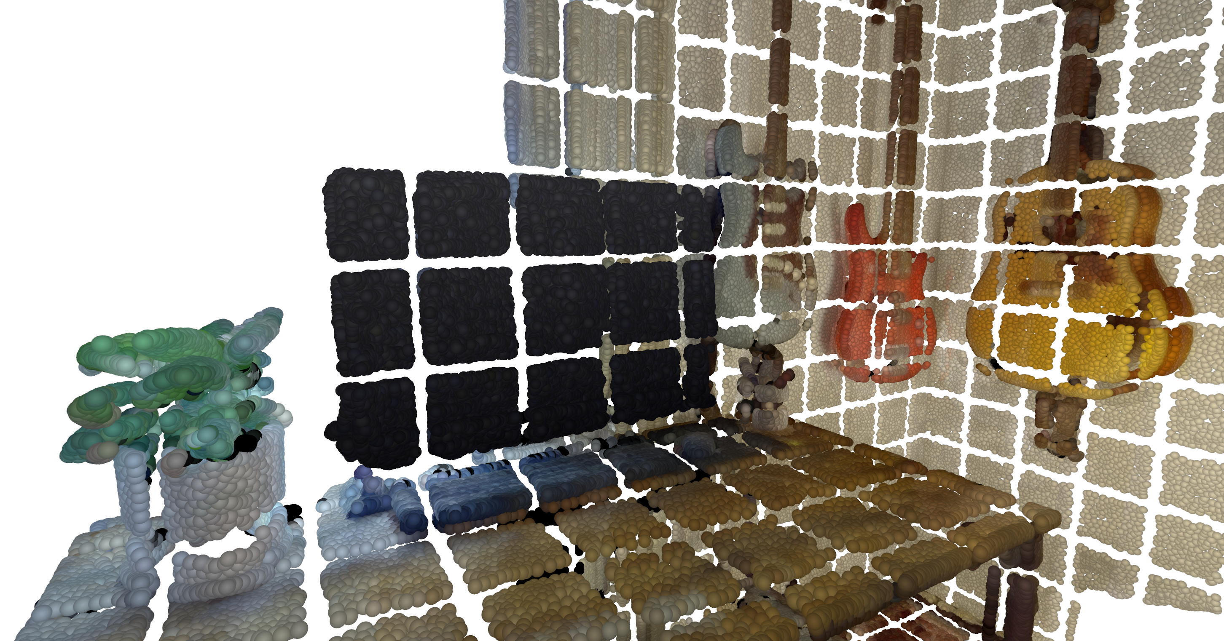
Bridging the Gap: Volume Transformer (Volt)
Patchified Input Point Cloud
Notes:
To bridge the gap, we propose a new backbone Volume Transformer. First, we voxelize the point cloud and for indoor scenes we use a voxel size of 2 cms. Then, we partition this voxelized 3D scene into cubic patches of 5x5x5 voxels. So, each patch is a cube of 10 cms.

Slide 9
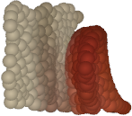
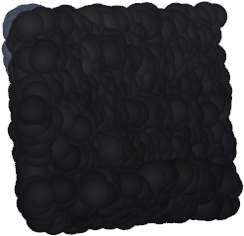
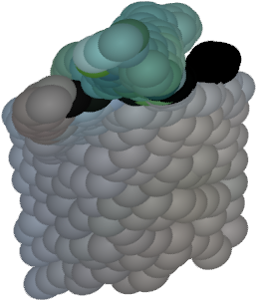
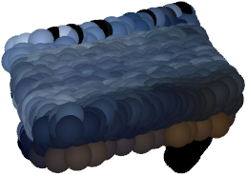
Bridging the Gap: Volume Transformer (Volt)
Patchified Input Point Cloud
Input Patches
Linear Tokenizer
Notes:
Next, we flatten each patch and linearly project it into a token.

Slide 10
Bridging the Gap: Volume Transformer (Volt)
Patchified Input Point Cloud
Input Patches
Linear Tokenizer
Transformer Encoder
Notes:
These tokens are then processed by a Transformer encoder with full global self-attention and for positional encoding we use 3D Rope. I want to highlight that this is a standard Transformer encoder. So, one could literally load the weights of a ViT encoder.

Slide 11
Bridging the Gap: Volume Transformer (Volt)
Patchified Input Point Cloud
Volt ⚡️
Input Patches
Linear Tokenizer
Transformer Encoder
Notes:
We call the resulting architecture the Volume Transformer. It is as you can see quite similar to a ViT,.

Slide 12
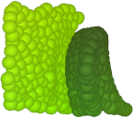
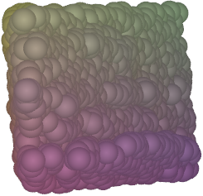
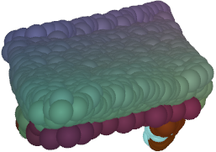
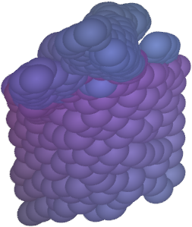
Bridging the Gap: Volume Transformer (Volt)
Patchified Input Point Cloud
Volt ⚡️
Input Patches
Linear Tokenizer
Transformer Encoder
Transposed Convolution
Patch Features
Notes:
Since the task is segmentation, we need to go back to the original voxel resolution. We do this with a single transposed convolution.

Slide 13
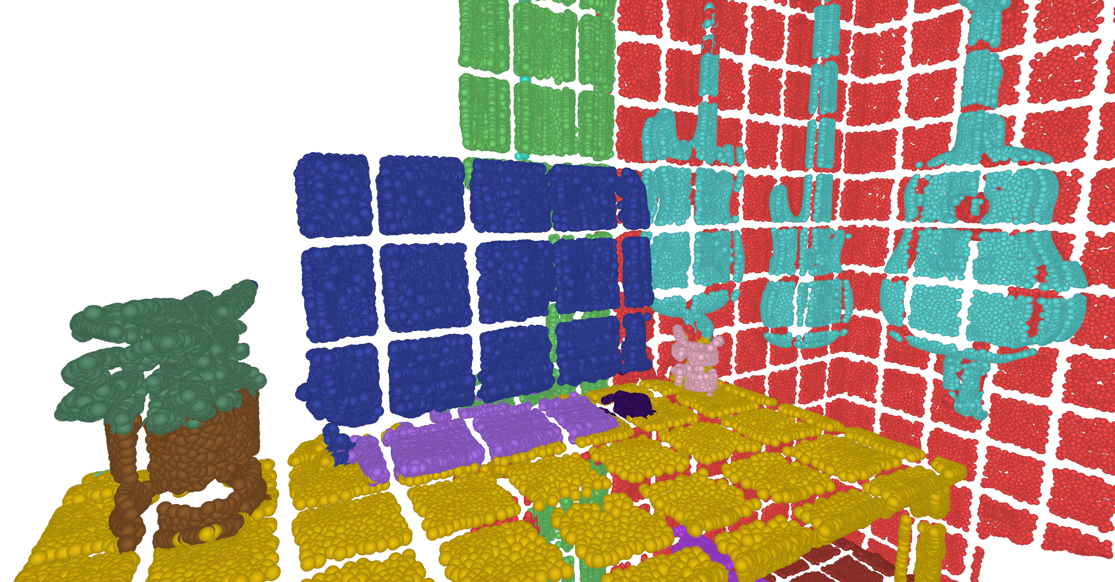
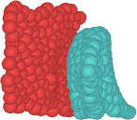
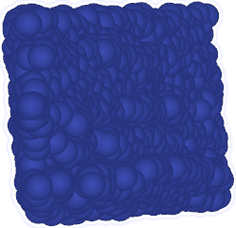
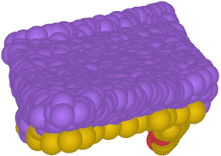
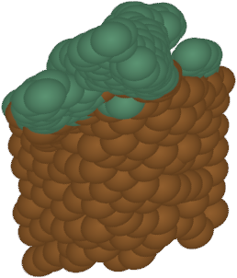
Bridging the Gap: Volume Transformer (Volt)
Patchified Input Point Cloud
Volt ⚡️
Input Patches
Linear Tokenizer
Transformer Encoder
Semantic Segmentation
Transposed Convolution
Patch Features
Linear Classification Head
Segmented Patches
Notes:
Finally, a linear classification head predicts the segmentation logits. So, this is the architecture. STOP One common question that I get after explaining Volt to someone is that: isn't full global attention expensive?

Slide 14
Isn’t Global Attention Expensive?
Notes:
Not really. Typical 3D scenes contain around five to ten thousand tokens. At this scale, global attention is quite fast with FlashAttention. For example, our larger model, Volt-B, uses the same Transformer encoder configuration as ViT-B and, it is about two times faster than the small PTv3 model and requires half the memory. So, Volt is simple and fast. The next question is: how well does it segment?

Slide 15
Naive Training of Volt
:(
Notes:
To test this, we trained PointTransformer models, MinkUNet, and Volt-S using the PTv3 training configuration. The results are discouraging at first. PTv3 performs well, MinkUNet is weaker, and Volt is the worst. But this is somewhat expected. Because, Volt is a Transformer with minimal inductive bias, so it needs a lot of data to learn patterns. Otherwise, it tends to overfit.

Slide 16
Naive Training of Volt
Hope!
Notes:
We then scale up the training data and see that Volt kind of catches up, but there is still not enough annotated 3D data to completely close the gap. Then, we looked at the 2D vision literature to see how people train Transformers when data is limited? In particular, the papers How to Train Your ViT and Data-Efficient Image Transformers were very useful.

Slide 17
Training Recipe
PTv3 config with Volt
35.2
31.0
Notes:
Inspired by these, we designed a training recipe for Volt. Let’s start from the baseline experiment on ScanNet200. As we just saw, Volt is clearly behind PTv3 under the standard training setup.

Slide 18
Training Recipe
Mix3D, Random crop, Rotate, shift and scale objects
35.5 (+0.3)
32.9 (+1.9)
Notes:
Then we do strong data augmentation including randomly mixing scenes, random crop, and randomly shifting rotating scaling objects. With this, Volt improves substantially, while PTv3 only improves slightly.

Slide 19
Training Recipe
DropPath, Weight Decay, Label Smoothing
35.5 (+0.0)
34.1 (+1.2)
Notes:
The second component is strong regularization including high droppath, weight decayin Adam and label smoothing. Again, Volt benefits a lot from this, while PTv3 does not gain anything.

Slide 20
Training Recipe
Use segmentation predictions of a pre-trained MinkUNet as auxiliary targets
36.2 (+2.1)
35.8 (+0.3)
Notes:
Finally, we add an auxiliary distillation objective. When training Volt, we use segmentation predictions of a pretrained MinkUNet as auxiliary targets. The last layer of Volt normally has one linear head that predicts ground-truth segmentation labels. We add a second linear head in parallel that predicts the distillation targets.

Slide 21
Training Recipe
Not a typical distillation setup. MinkUNet “Teacher” is worse than student.
36.2 (+2.1)
35.8 (+0.3)
CNN Teacher (29.1)
Notes:
This is not a typical distillation setup, because the MinkUNet teacher is actually weaker than the Volt student. STOP So why does it help? Our interpretation is that distillation acts more like a regularizer. The ground-truth labels stay fixed during training, but the MinkUNet predictions change under data augmentations. We think this gives Volt an additional training signal and prevents overfitting.

Slide 22
Training Recipe
ScanNet200 → ScanNet200 + ArkitScenes + ScanNet++
38.1 (+1.9)
36.7 (+0.9)
Notes:
After applying this recipe, scaling the data again gives us a large improvement.

Slide 23
Training Recipe
Volt-S (23.7M) → Volt-B (94.3M) PTv3-S (46.1M) → PTv3-B (124.8M)
40.0 (+1.9)
37.5 (+0.8)
Notes:
Scaling the model size also gives another clear improvement.

Slide 24
Volt Scales Better with Data
5x params
Notes:
Here is the same plot, but now with the full training recipe. The picture changes completely. Even Volt-S, which is one fifth of the PTv3-B in terms of parameters, surpasses it across the board. At the largest scale, Volt-B leaves the other models behind.

Slide 25
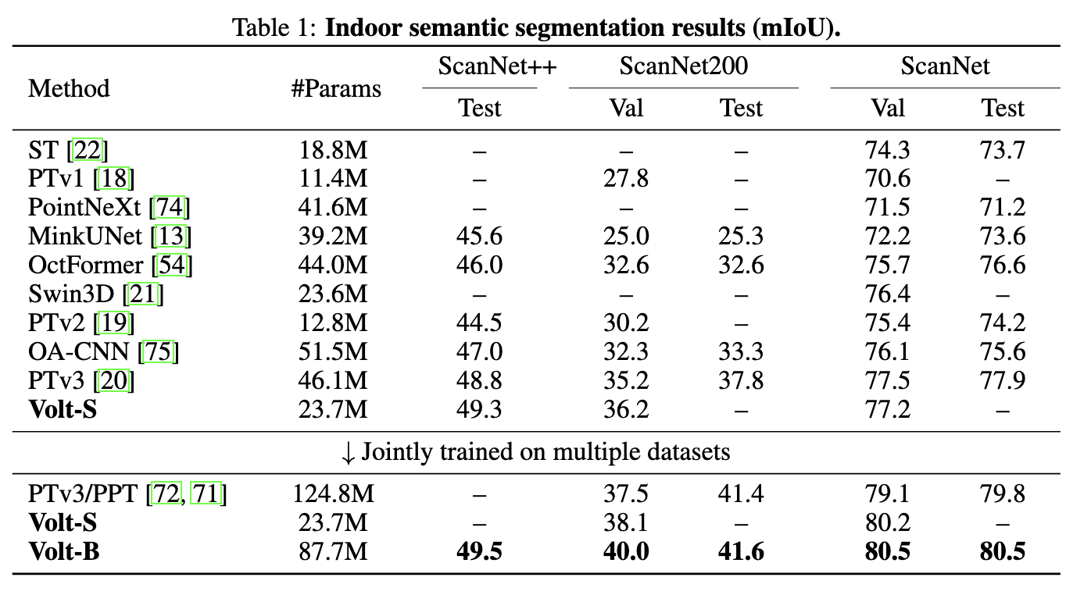
Volt Achieves New Best Scores
Notes:
With this training recipe, Volt sets new best results across the board on ScanNet, ScanNet200 and ScanNet++ validation and test sets.

Slide 26






Instance Segmentation (SPFormer)
Input Point Cloud
$$ℰ1$$
$$ℰ2$$
$$ℰ3$$
$$𝒟3$$
$$𝒟2$$
$$𝒟1$$
Instance Segmentation
Transformer Decoder
Transformer Decoder
Transformer Decoder
Transformer Decoder
Object Queries
Notes:
Next, we apply Volt to instance segmentation. For this, we start from an established 3D instance segmentation pipeline SPFormer which uses MinkUNet as its backbone.

Slide 27
Volt as Backbone for Instance Segmentation
Input Point Cloud
Volt ⚡️
Input Patches
Linear Tokenizer
Transformer Encoder
Instance Segmentation
Transposed Convolution
Transformer Decoder
Transformer Decoder
Transformer Decoder
Transformer Decoder
Object Queries
Notes:
We simply replace the MinkUNet backbone with Volt and train the model with the instance segmentation objective.

Slide 28
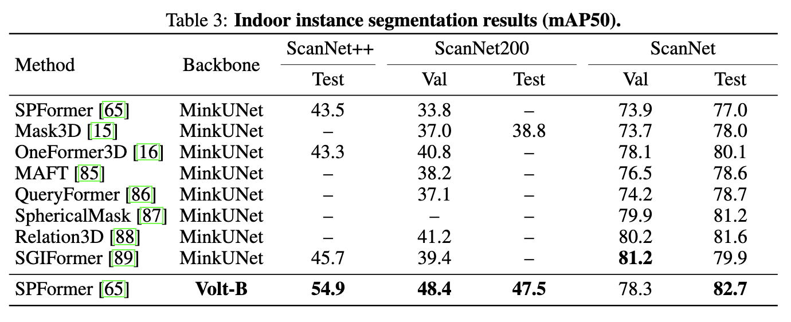
Instance Segmentation Results
Notes:
Here are the results. Replacing the backbone with Volt gives strong improvements across datasets and sets new best results on the ScanNet, ScanNet200, and ScanNet++ test sets. This shows the power of Volt as a feature extractor.

Slide 29
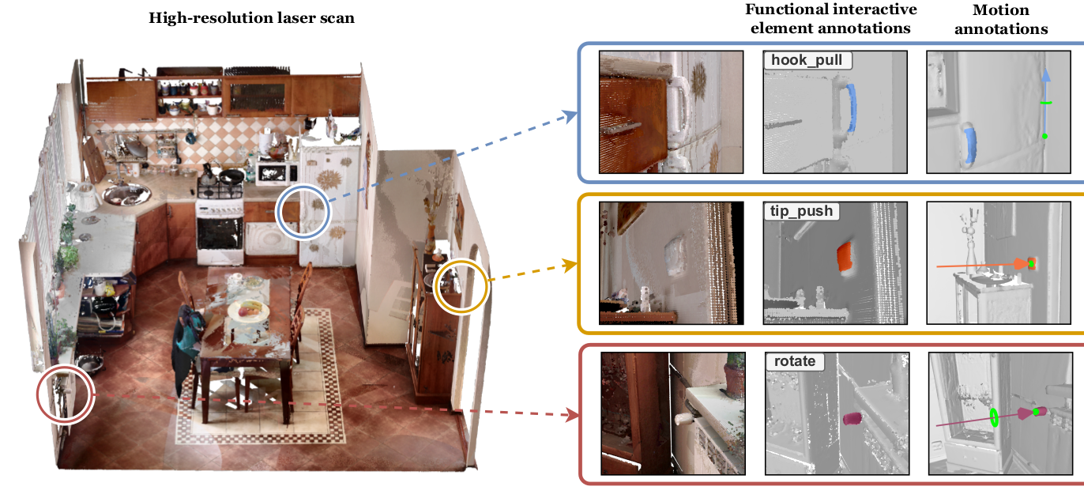
SceneFUN3D Challenge
Image taken from SceneFUN3D paper
Notes:
The SceneFUN3D challenge is a bit different in the sense that you need to segment the scene in terms of affordances not object categories. So, you have to segment these tiny object like light switch, power outlets or door handles. It is a really hard task. What we did is basically take a Volt checkpoint and fine tune on this data.

Slide 30
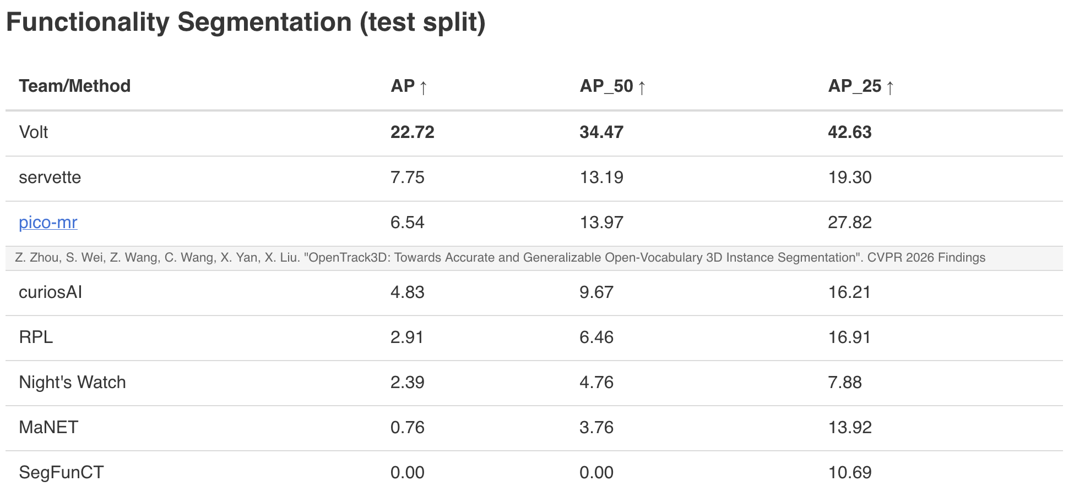
SceneFUN3D Results
Notes:
Here are the results. Replacing the backbone with Volt gives strong improvements across datasets and sets new best results on the ScanNet, ScanNet200, and ScanNet++ test sets.

Slide 31

ViT moment for 3D Scene Understanding
New ViT-style backbone for 3D scenes
Fast and memory efficient even with global attention
Use the training recipe for training from scratch
Better scaling with more data
Better scaling with new hardware/software
Enables transfer of research from the general scientific community
Volt Project Page
Notes:
To wrap up, we believe this could be a ViT moment for 3D scene understanding. We showed that Volt is a simple ViT-style 3D backbone. It is fast, and with the right training recipe it achieves very strong results. It scales well with more data, larger models, and new hardware and software. Most importantly, we hope it will make it easier to transfer ideas from the broader deep learning community into 3D scene understanding. Thank you.

